Slide 1
STREAM ANALYSIS FOR CAREER CHOICE APTITUDE TESTS
SANA VK
(TCR19MCA022)
Guided By Prof.Husain Ahamed P
MCA Semester VI
Department Of Computer Application
Government Engineering College, Thrissur
Main Project Final Review May 2022

Slide 2
Outline
1- INTRODUCTION
2- EXISTING SYSTEM
3- PROPOSED SYSTEM
4-MODULES
5- ARCHITECTURE DIAGRAM
6- REQUIREMENT SPECIFICATION
7- RESULTS
8- FUTURE ENHANCEMENT
9- CONCLUSION

Slide 3
INTRODUCTION
Most of the users are confused while selecting their streams according to their capability
User can select career choice based on their IQ.
The main aim of the project is to help user for choosing their career option.
System helps the user to select their career choice according to their interest in particular field.
Users attend exams and the score in these exams are considered to recommend streams

Slide 4
Existing system
In existing system, students learn about various courses from many sources, such as advertisements, internet, friends etc.
But they may be confused to choose from this list as it may contain a lot of courses.
Students tend to choose courses with less fee structure. In most cases, students do not opt for courses that match their skills.

Slide 5
proposed SYSTEM
In our proposed system, we conduct tests or exams.
Registered candidates can attend these exams.
On completion of the exam, their score is updated to the server.
Based on their score counsellors can recommend them to agencies.
Thus the students get recommendation of courses.

Slide 6
MODULES
ADMIN
Course Details-Admin can add main course name
Main Stream-Admin can add main stream under course details
Sub Stream-If there is any sub stream for mainstream admin can add accordingly
Question-Admin can add questions based on main stream and sub stream
View Student Details-Admin can view details of registered students
View Exam Details-Admin can view student IQ test result
2. STUDENT.
Take test-User had to select desired stream and must give test accordingly.
System will generate question paper based on the stream selected
Results-User can view previous and current exam results

Slide 7
3. COUNSELLOR
Review the candidate performance
Interact with candidate to recommend courses
Notify agencies about candidates
4. AGENCY
Manage course details
Interact with candidate
Manage admission of candidate

Slide 8
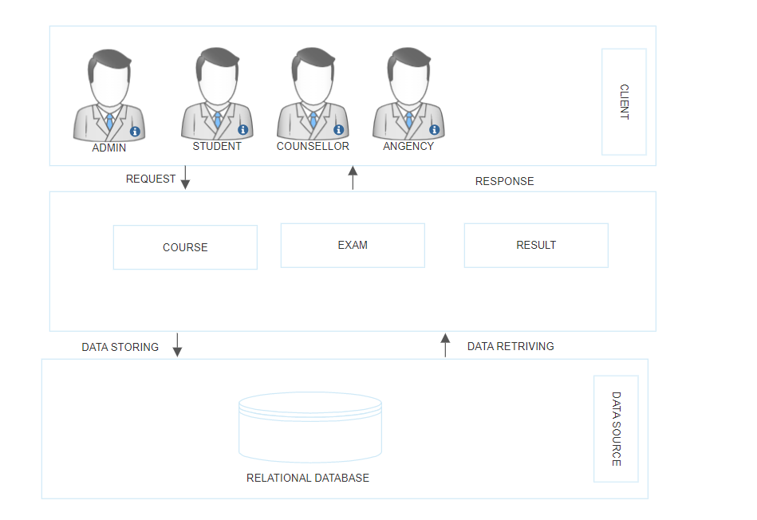
ARCHITECTURE DIAGRAM

Slide 9
REQUIREMENTS
REQUIREMENTS
SOFTWARE REQUIREMENTS
Operating System : Windows 8 or above
Front End : HTML, CSS, JavaScript
Back End : Python ,Android, MySQL
IDE : PyCharm, Android Studio
Framework : Flask
HARDWARE REQUIREMENTS
Processor : Intel Core i3 or above
Hard Disk Space : 320 GB
Memory : 4 GB RAM or above

Slide 10
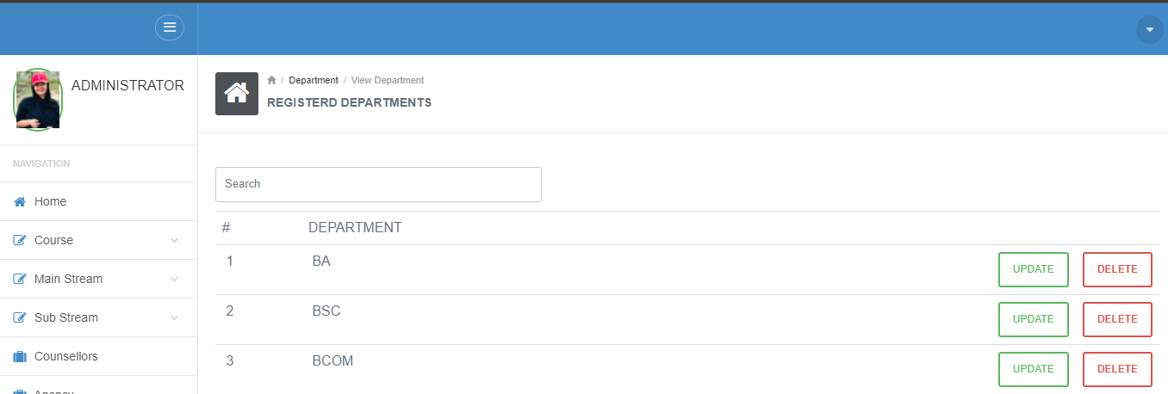
RESULTS – Web application
Listed Courses
Update and Delete Option

Slide 11
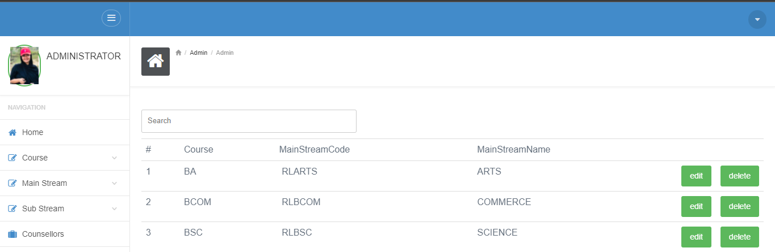
Main Streams
Edit & Delete Options

Slide 12
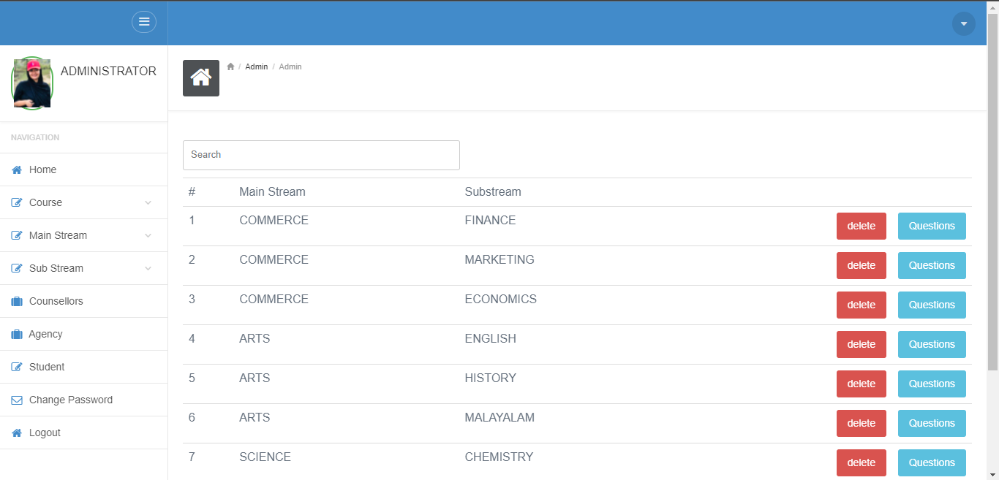
Sub Stream
Delete Option
Add Question

Slide 13
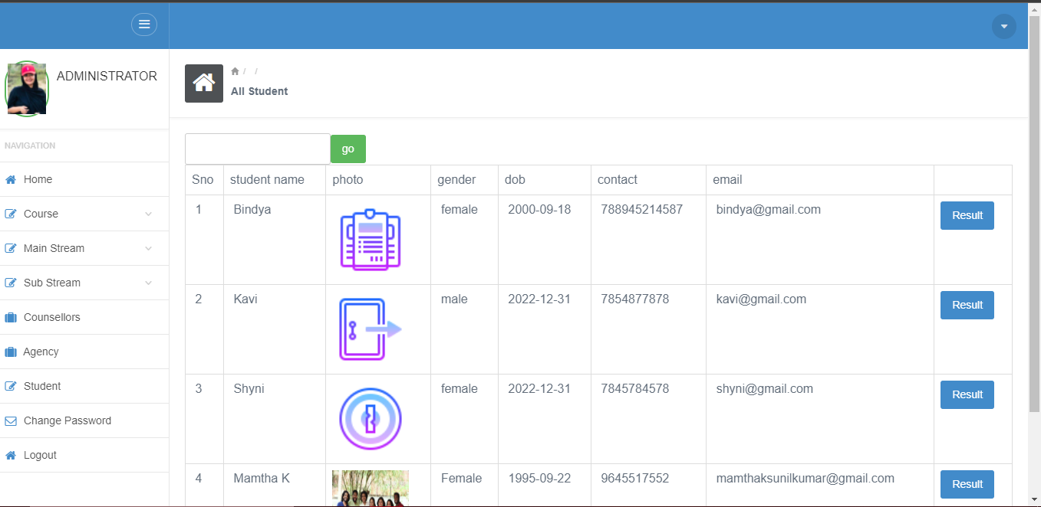
Student details

Slide 14
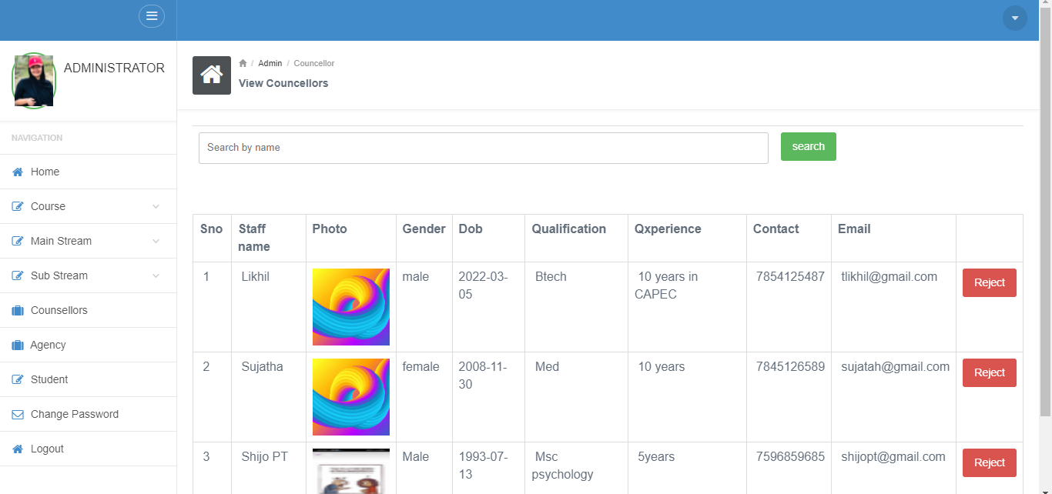
Counselor details
Reject Counselor

Slide 15
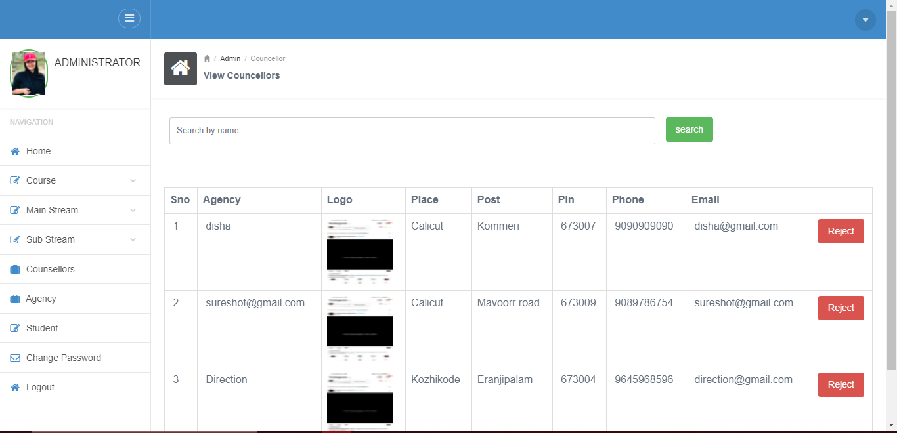
Agency details

Slide 16
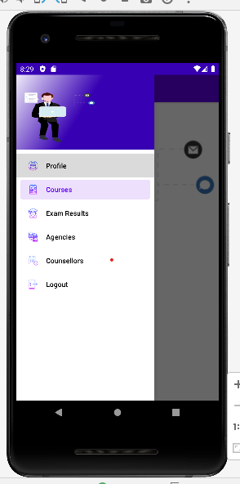
Result-android

Slide 17
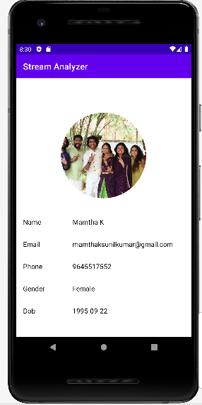
STUDENT DETAIL

Slide 18
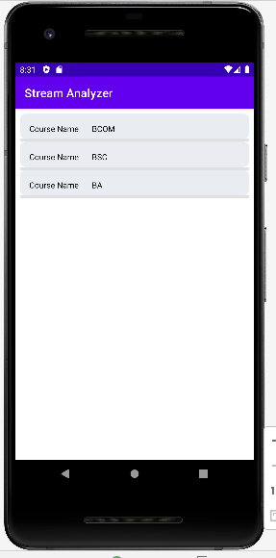
EXAM-SELECT COURSE(BA)

Slide 19
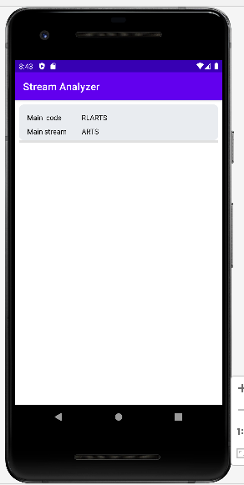
SELECT MAIN STREAM(ARTS)

Slide 20
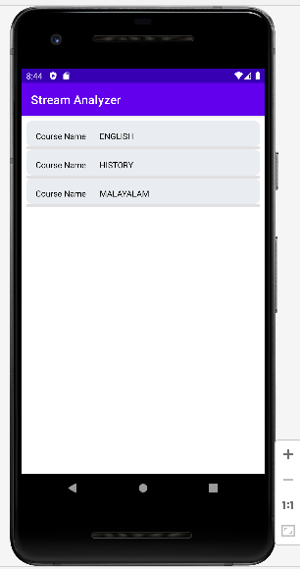
SELECT SUBSTREAM
SELECT SUBSTREAM(MALAYALAM)

Slide 21
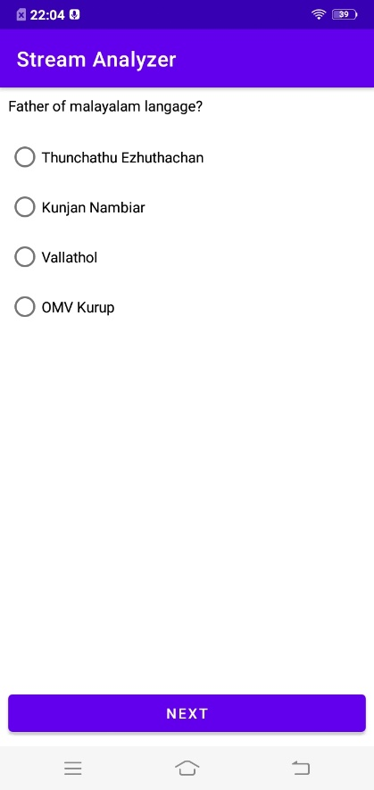
EXAM QUESTIONS

Slide 22
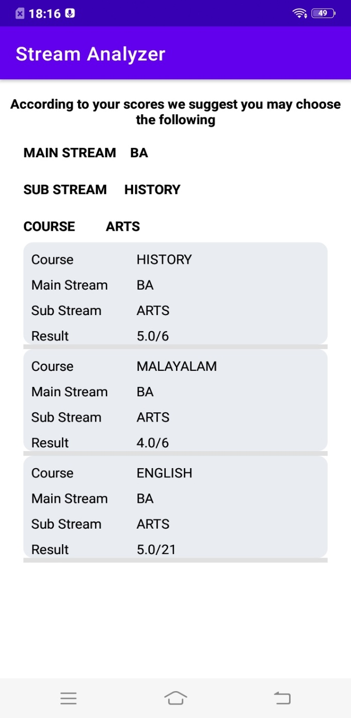
EXAM RESULT & SUGGESTION

Slide 23
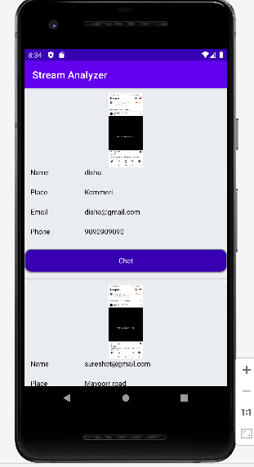
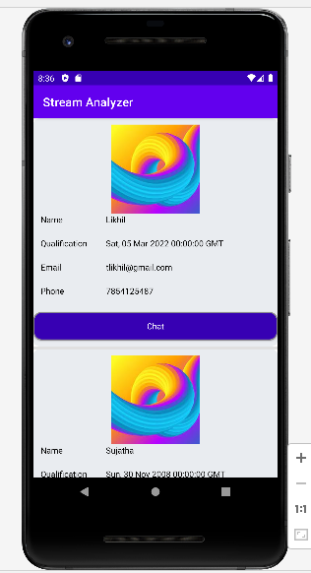
COUNCELLOR & AGENCY

Slide 24
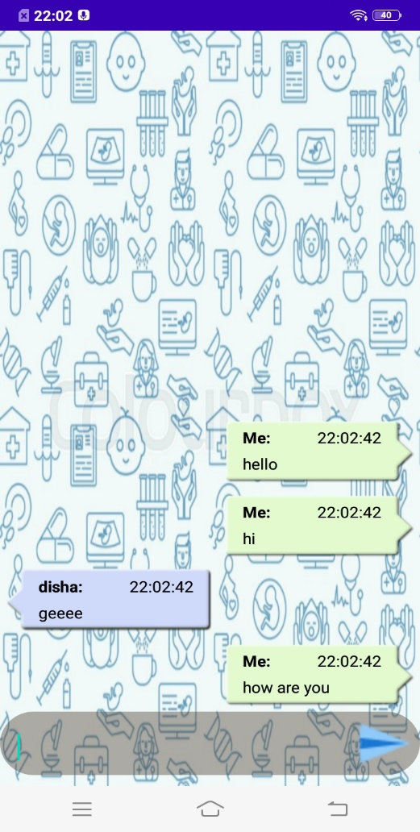
CHAT BOT

Slide 25
FUTURE ENHANCEMENT
In the future the work could be extended. Since the proposed project is targeted only for the HSC and SSC students, there still remains a wide scope for growth. In the future more functionality can be added which will facilitate the stream analysis of students from various different streams and majors. Some of the streams which can be added in the future are Engineering, medical, MBA etc. For example an engineering student can give an online aptitude test to determine which specialization he\she should pursue his BE degree in example Civil Mechanical, CSE etc.

Slide 26
CONCLUSION
The advantage of the system over existing system was the lack of confusion in choosing courses from given set. In existing system, students get confused while choosing from a lot of courses, which may result in choosing courses that do not match their skills. The proposed system proves to be very helpful for students in choosing courses that suit their skills.

Slide 27
THANK YOU

